Slide 1
Agile Software Development

Slide 2
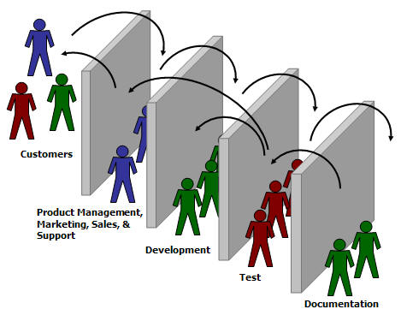
Why Agile Software Development
Notes:
http://agile.scumniotales.com/2006/07/why_be_agile.html

Slide 3
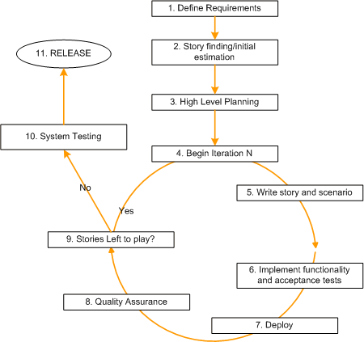
Overview of Agile Process
Notes:
Define Requirements
Story Finding / Initial Estimation
High-Level Planning
Begin Iteration N
Write User Stories and Scenarios
Implement Functionality and Acceptance Tests
Deploy
Quality Assurance
Stories Left to Play?
System Testing
Release

Slide 4
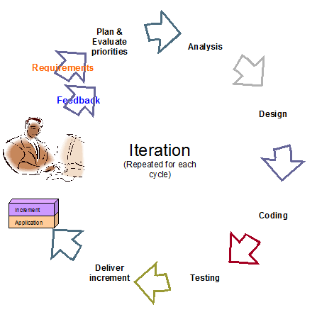
Agile Software Development Cycle

Slide 5
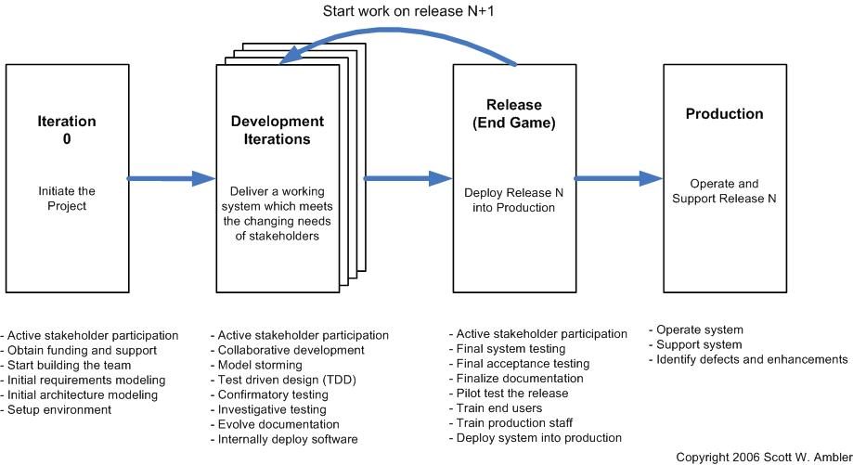
Release Cycle
Notes:
AMDD – Agile Model Driven Development
http://bestofcyber.wordpress.com/2007/02/09/amdd-agile-model-driven-development/

Slide 6
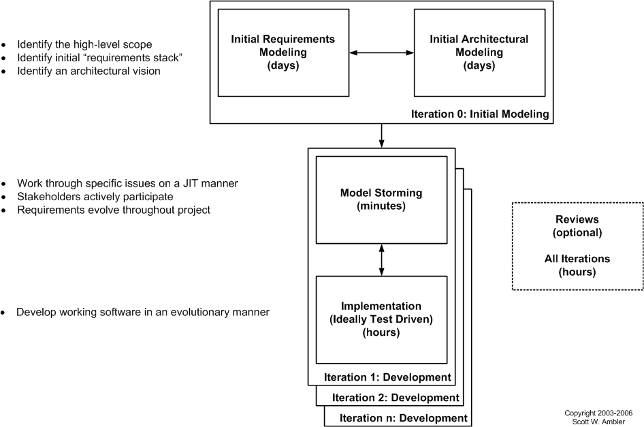
The Agile Model Driven Development (AMDD) Lifecycle

